Slide 1
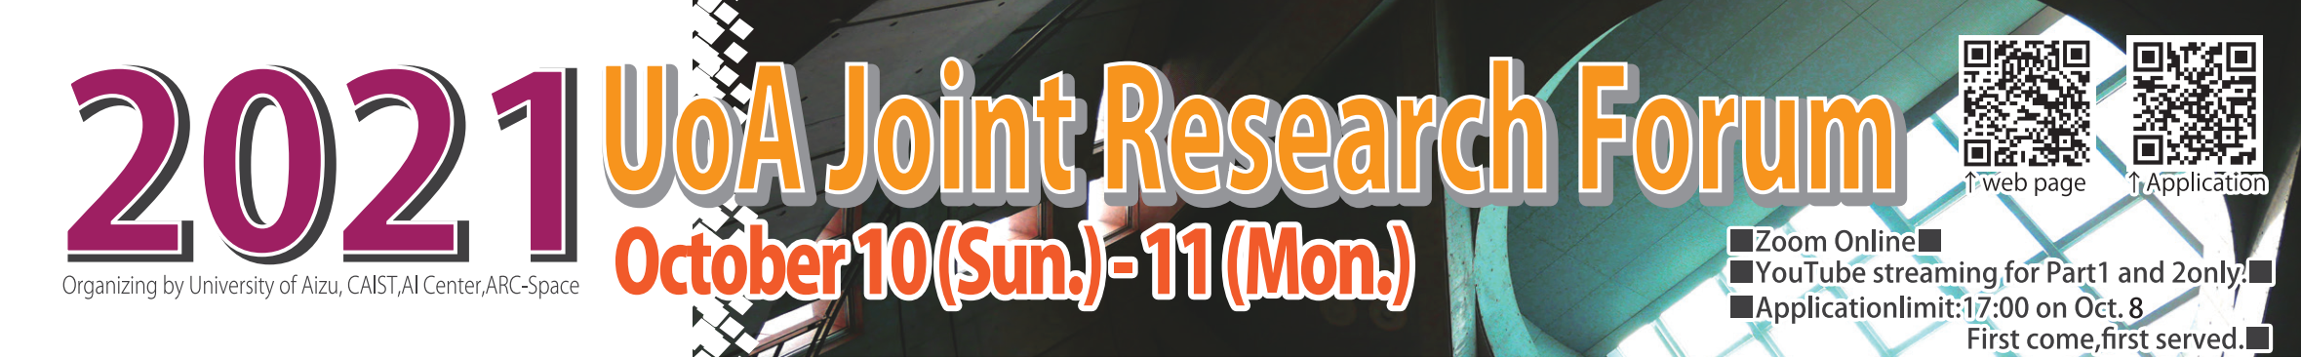
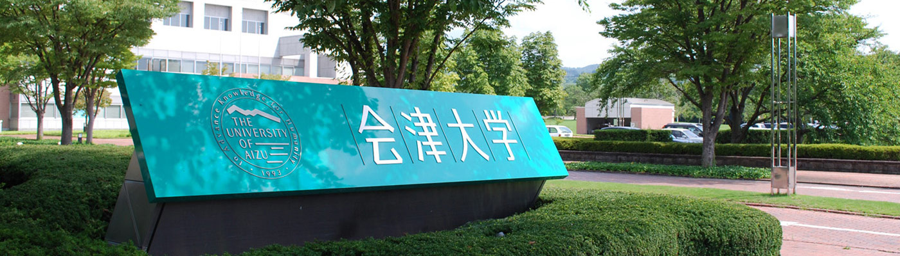
Vision and Sensor-Based System for
Human Activity Recognition and
Automatic Control using
Machine Learning
Dr. Jungpil SHIN
Pattern Processing Lab. The University of AIZU, JAPAN E-mail: jpshin@u-aizu.ac.jp
Notes:
Good morning! My name is Jungpil SHIN, in Pattern Processing Lab. UoA. １０：３５ １１：００ 13:08
The presentation Title is Vision and Sensor-Based System for Human Activity Recognition and
Automatic Control using Machine Learning
こんにちは、パターン処理学講座のシンです。
タイトルは 機械学習に基づいた、画像とセンサデータによる人間の行動認識と移動体の自動制御システム です。

Slide 2

Vision Computing Platform Cluster
Research Power Reinforcement
Principal Investigator: Dr. Jungpil SHIN
Pattern Processing Lab. The University of AIZU, JAPAN E-mail: jpshin@u-aizu.ac.jp
Notes:
The Given Cluster name is ..
The Tentative Cluster name for the Research Power Reinforcement is ..

Slide 3
Vision Computing Platform Cluster (Shin, Okuyama, Tomioka, Nishimura, Asai, Suzuki)
The Purpose of Cluster-Project :
The mission of this cluster is to develop and improve strategies to enhance collaboration and interaction on the research topics, such as pattern recognition, human-computer interaction, computer vision and image processing, computer graphics, and embedded systems.
This group conducts research and development of algorithms for control and decision making using the functionality of DNN, and images and videos are considered as input.
The research plan relies on novel interactions, mixed realities, visualizations, and collaborative technologies to promote HCI and autonomous driving.
Human Computer Interaction
Image Processing
Pattern Recognition
Computer Vision
Embedded System
Computer Graphics
Vision Computing Platform Cluster (Shin, Okuyama, Tomioka)
Notes:
The Cluster-Project Purpose:
The mission of this cluster is to develop and improve strategies to enhance collaboration and interaction on the research topics, such as pattern recognition, human-computer interaction, computer vision and image processing, computer graphics, and embedded systems.
This group conducts research and development of algorithms for control and decision making using the functionality of DNN, and images and videos are considered as input.
The research plan relies on novel interactions, mixed realities, visualizations, and collaborative technologies to promote HCI and autonomous driving
クラスター・プロジェクトの目的
このクラスターの目的は、
パターン認識、ヒューマン・コンピュータ・インタラクション、コンピュータビジョンと画像処理、コンピュータグラフィックス、組み込みシステムなどの
研究テーマについて、共同研究や相互の情報交換を強化していくことです。
このグループでは、画像を主要な入力としたシステムにおいて、
深層学習の機能を利用した制御や意思決定のためのアルゴリズムの研究開発を行います。

Slide 4
Vision Computing Platform Cluster (Shin, Okuyama, Tomioka, Nishimura, Asai, Suzuki)
Role of each member;
1) SHIN, Jungpil Coordinator, Implementation and test of applications
2) OKUYAMA, Yuichi Maintaining estimation and automatic control, optimization of the networks,
3) TOMIOKA, Yoichi Acceleration of vision applications
4) NISHIMURA Satoshi Implementation of Image Generation.
5) SUZUKI Taro Implementation of HCI network in differentiable functional language.
6) ASAI Nobuyoshi Experiment of proposed(optimized) network.
Human Computer Interaction
Image Processing
Pattern Recognition
Computer Vision
Embedded System
Computer Graphics
Keywords : Human-computer interaction, Hand Gesture, Non-touch interface, Handwriting action, Video-based sensors, Automatic control, Medical diagnosis and recognition, Deep learning
Notes:
Human-computer interaction (HCI) is a multidisciplinary field of study focusing on the design of computer technology and, in particular, the interaction between humans (the users) and computers.
There are different types of applications such as, Human-computer interaction, touch free interface, air-writing, virtual reality, brain-computer interface etc.
Recently, gesture recognition plays an important role in HCI especially the hand is the most convenient and direct way of expressing our feelings compared to the other part of the body
The depth camera can capture RGB information as well as depth information and is effective as a non-touch interface
下記のコメントは微妙です。
１．画像の入力をメインとしたDNNを扱う
We use DNNs that deal with image/videos.
２．画像から、機器を制御するための情報を取り出す。
または、画像から直接機器を制御する。
The system contains DNN part and desision-making part.
DNNs extract information to control devices from images, and the pass the result to desition-makeing part.
Desision-making part makes dicitions to control devices and/or show results to human.
３．機器の制御は、教師あり学習から始める。
システムの効率を上げるために、自律的に学習し、制御を更新する技術を導入する。
制御を人間と協調して更新できるよう、DNNの判断の根拠を人間に説明する仕組みを作る。
We start from supervised lerning. We introduce autonomous learining/updating technologies in the disition-making part.
In order to update control part collaborate with human and AIs, we implement explanation technologies of AI decisions.
In explanation, we need computer graphics/AR technorogies to show the result.

Slide 5
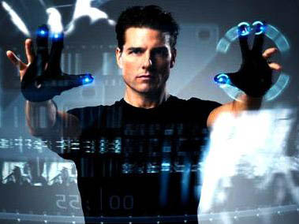

Introduction: Research Themes
The Project Purpose:
Research and analysis concerning Vision Computing
Vision Computing Platform Cluster
Non-touch Interface
Parkinson’s Disease Diagnosis
Handwriting Analysis and Recognition
Human Computer Interaction
User Authentic-cation
Handwriting Synthesis
Human Gesture Recognition
Automatic Control
ADHD Diagnosis
Notes:
In our cluster, Vision Computing Platform Cluster,
The following research themes are carried out.
Today I would like explain one theme the related on 3 Theme, HCI/ Non touch / Gesture.
ビジョンコンピューティングプラットフォームクラスタではこのようなテーマを実施しています。
ヒューマン・コンピュータ・インタラクション、
ノンタッチインターフェース、
人間のジェスチャー認識,
自動制御
パーキンソン病診断
ＡＤＨＤ診断
手書き文字の分析と認識
手書き合成
ユーザ認証
です。

Slide 6

Rotation, Translation and Scale Invariant Sign Word Recognition Using Efficient Segmentation and Deep Learning
Dr. SHIN Jungpil
Vision Computing Platform Cluster
The University of AIZU, JAPAN
Notes:
The title is American Sign Language Recognition by extracting feature from Hand Pose Estimation
本日は、アメリカ手話の指文字認識についてお話ししたいと思います。
6

Slide 7
Overview
Introduction
Back ground
Purpose
Previous study
Method
Joint estimater
Sign Language Word
Classfication
Data set
Result
CNN
Conclusion
Notes:
Overview
I will show the Introducition, method, result and conclusion
これが本日の発表の概要になります。
背景、手法、結果、結論をお話しします。

Slide 8
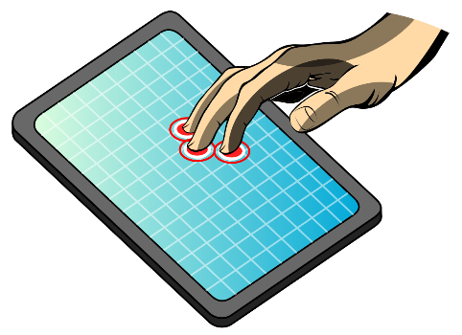
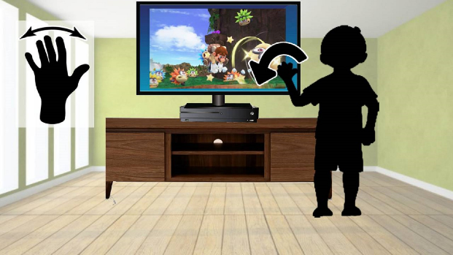
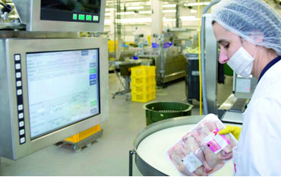
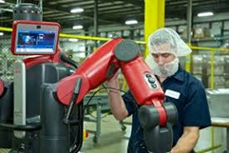
Introduction
Human-Computer Interaction techniques are enhancing
Touch and non-touch system
Touch device
Non-touch device
Touch devices: Limitations and Drawbacks
Unhygienic or unsafe
Security problems in user interference
Where the user cannot touch any device
Industrial environment
Notes:
human computer interaction techniques are enhancing.
There are many touch and non-touch devices, for example tablet display, smartphone,
Touch devices have Limitations and Drawbacks
This is Unhygienic or unsafe
Security problems happen in user interference
In Where the user cannot touch any device in some industry.
近年、人間とコンピュータのインターフェイスが強化されており、
タブレットやスマートフォン等のさまざまな接触型、非接触型デバイスがあります
接触型デバイスには
衛生上の安全性の問題
生体情報のセキュリティーの問題
ユーザーがデバイスを触ることができない場面で使用できない
などの欠点や限界があります

Slide 9
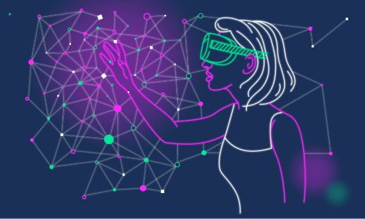
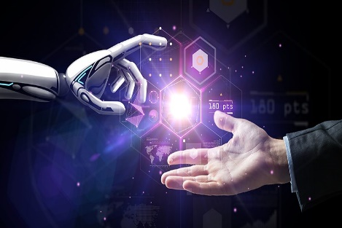
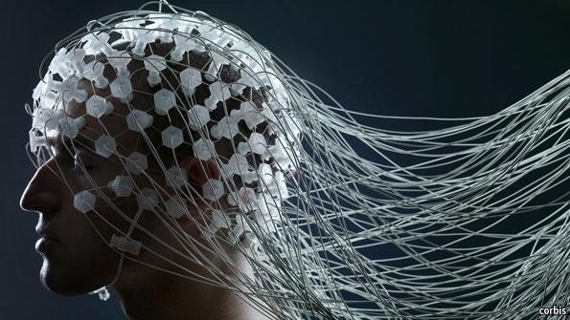
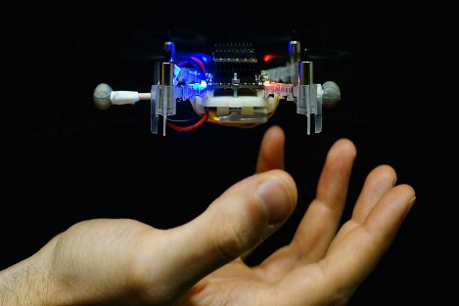
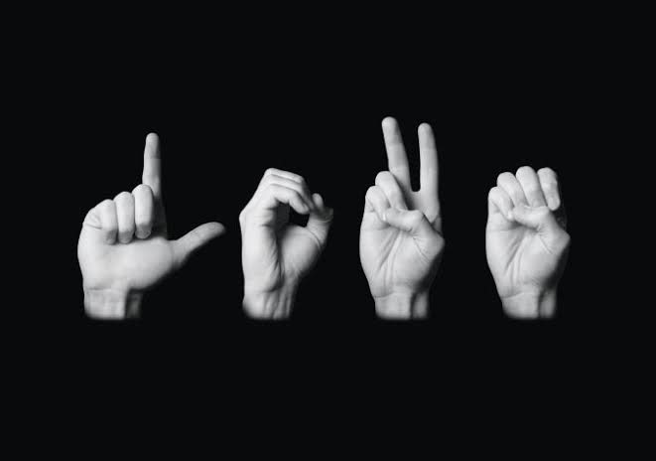
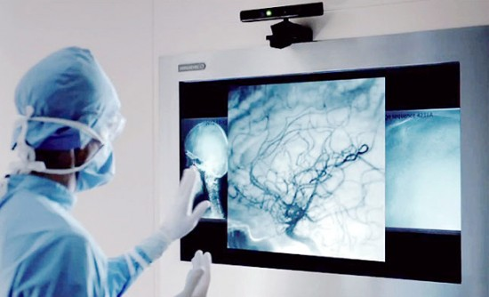
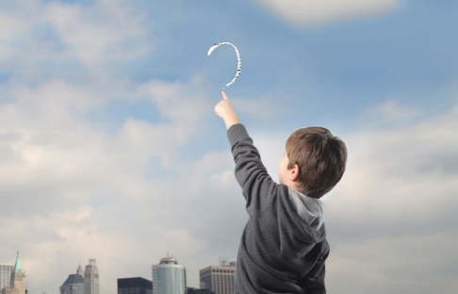

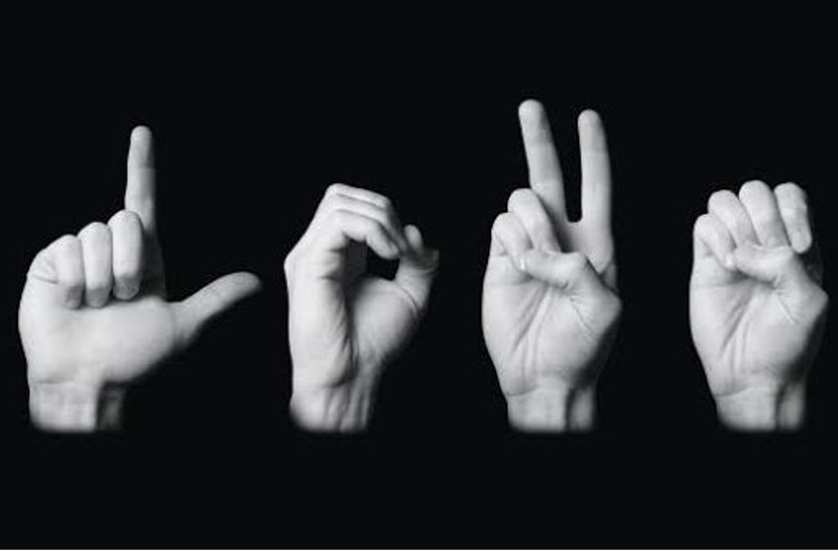
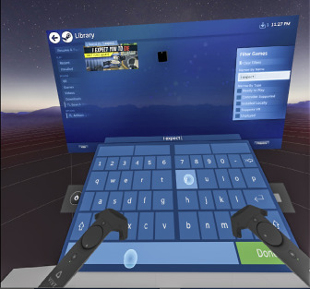
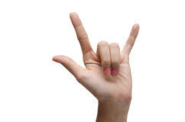
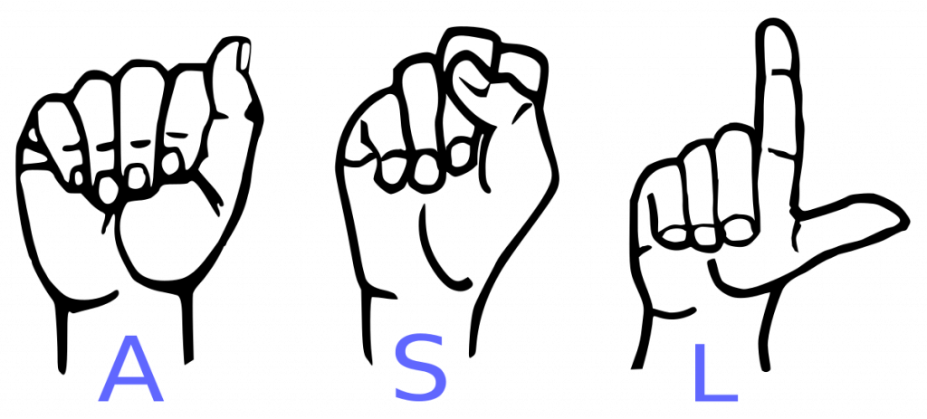
Introduction (Cont.)
Non-touch techniques, the user does not need to
Type on a keyboard
Write on a trackpad/touch screen
control smart/robot systems from insecure locations.
Applications
Virtual Reality
HCI
BCI
Touch-free Interface
Air writing
SLR
Medical Diagnosis
Character Input
Notes:
In non-touch techniques, the user does not need to type on a keyboard, write on a trackpad/touch screen, or control a smart system.
There have been many application of non-touch systems, such as virtual reality, HCI, brain-computer interface, touch free writing, aerial handwriting, sign languages recognition, medical application, char input. etc.
Today I will present on SLR.
ノンタッチ技術を使うことで
ユーザーはキーボードで入力したり、
トラックパッドやタッチスクリーンで書いたり制御したりする必要がなくなります。
これまでにも、仮想現実、人間とコンピュータのインターフェイス、脳とコンピュータインターフェース、非接触インターフェイス、
空中手書き、手話認識、医療アプリケーション、文字入力など、様々な場面で応用されてきました。

Slide 10
Background
In the real world, when a deaf-mute person is trying to make a new sign word to test the model, the test image could be taken from the upper, lower, left, and right-hand positions.
Test image may be rotated, translated or scaled due to an inappropriate hand position.
The model may face some difficulties producing correct output for that type of test image.
Purpose
Train the model with the RTS version of the dataset.
A novel CNN architecture for feature extraction and classification
Notes:
I will talk about background of this research. We usually use a variety of methods to input text. One of the main examples is keyboard input. Keyboard input is the current mainstream input method and is used by many people. However, keyboards can come into contact with an unspecified number of people. It is said that many bacteria exist on a keyboard that has not been sterilized, and this is a major drawback from a hygiene standpoint. In recent years, there has been a growing demand for non-contact interfaces that allow input without the hand touching the object. For example, there have been studies using various types of devices such as wearable sensors, cameras with built-in depth sensors such as Kinect, eye movements, and even leap motion. These devices allow users to input text without touching the keyboard. They are able to input text without touching is quite hygienic, and is expected to reduce the risk of contact infections. However, sensors with depth sensors such as kinect are expensive and not very convenient to use.

Slide 11
Previous study
Table 1. Previous works performances at a glance including the approach and classifier used.
Reference | Method | Dataset | No. of Image | Accuracy(%)
Kumar et al[1] | HMM, BLSTM-NN | 20-ISL | 7500 | 97.85, 94.55
Wu et al. [2] | LibSVM | 80-ASL | 24 000 | 96.16
Li Y et al.[3] | MSHMM | 120- CSL | 13920 | 96.5
Tubaiz et al. [4] | MKNN | 40-ArSL | Sensor data | 98.9
Rahim et al.[5] | Positioning palm point | 15-People | Sensor data | 96
Hu et al.[6] | SVM | 24-ASL | 120,000 | 91.6
Starner et al.[7] | HMM | 40-ASL | 500 | 92
Lee et al[8] | SVM | 28-ASL | Sensor data | 98.2
Shin et al. [9] | hand tapping gestures | Finger left, right | Kinetic Sensor | 96.7
Chong et al.[10] | DVM-DNN | 36-ASL | LMC | 72.79, 88.79
Jain et al.[11] | SVM, CNN | 36-ASL | No | 98.58
Rahim et al.[12] | SVM | Sign word | 18000 | 97.28

Slide 12
Previous study
Kumar P, Gauba H, Roy PP, Dogra DP. A multimodal framework for sensor based sign language recognition. Neurocomputing. 2017 Oct 11;259:21-38.
Wu J, Sun L, Jafari R. A wearable system for recognizing American sign language in real-time using IMU and surface EMG sensors. IEEE journal of biomedical and health informatics. 2016 Aug 25;20(5):1281-90.
Li Y, Chen X, Zhang X, Wang K, Wang ZJ. A sign-component-based framework for Chinese sign language recognition using accelerometer and sEMG data. IEEE transactions on biomedical engineering. 2012 Mar 16;59(10):2695-704.
Tubaiz N, Shanableh T, Assaleh K. Glove-based continuous Arabic sign language recognition in user-dependent mode. IEEE Transactions on Human-Machine Systems. 2015 Mar 16;45(4):526-33.
Rahim MA, Shin J, Islam MR. I. Human-Machine Interaction based on Hand Gesture Recognition using Skeleton Information of Kinect Sensor In Proceedings of the 3rd international conference on applications in information technology 2018 Nov 1 (pp. 75-79).
Hu, Y. Finger spelling recognition using depth information and support vector machine. Multimed Tools Appl 77, 29043–29057 (2018). https://doi.org/10.1007/s11042-018-6102-6
Starner T, Weaver J, Pentland A. Real-time American sign language recognition using desk and wearable computer based video. IEEE Transactions on pattern analysis and machine intelligence. 1998 Dec;20(12):1371-5.
Lee BG, Lee SM. Smart wearable hand device for sign language interpretation system with sensors fusion. IEEE Sensors Journal. 2017 Dec 4;18(3):1224-32.
Shin J, Kim CM. Non-touch character input system based on hand tapping gestures using Kinect sensor. IEEE Access. 2017 May 11;5:10496-505.
Chong TW, Lee BG. American sign language recognition using leap motion controller with the machine learning approach. Sensors. 2018 Oct;18(10):3554.
Pisharady PK, Saerbeck M. Recent methods and databases in vision-based hand gesture recognition: A review. Computer Vision and Image Understanding. 2015 Dec 1;141:152-65.
Jain V, Jain A, Chauhan A, Kotla SS, Gautam A. American Sign Language recognition using Support Vector Machine and Convolutional Neural Network. International Journal of Information Technology. 2021 Jun;13(3):1193-200.

Slide 13
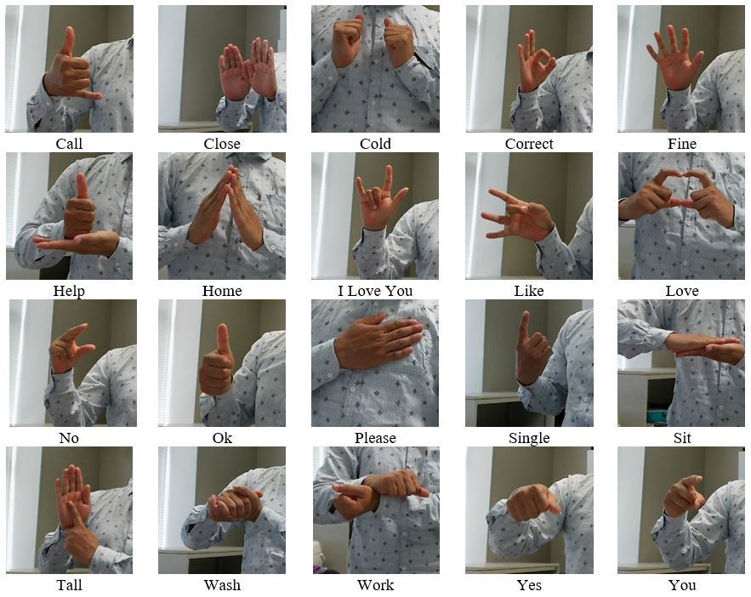
Sign Language Work
Sign Language Word is a sign language used in English-speaking countries such as the United States and Canada, and can express the word.

Slide 14
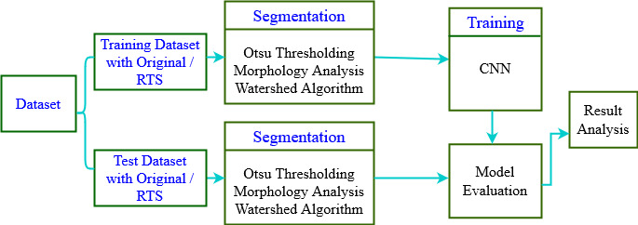
Working Flowgraph
Firstly, we have developed a Rotated, Translated, and Scaled (RTS) version of dataset to solve RTS issue in the test or future images.
Secondly, we have designed a hybrid segmentation approach to reduce the redundant background of the images by combining Otsu Thresholding, Morphological analysis, dilation through opening morphology, and Watershed algorithm.
Finally, we propose a novel convolutional neural network (CNN) architecture model for extracting features and classifying sign words.

Slide 15
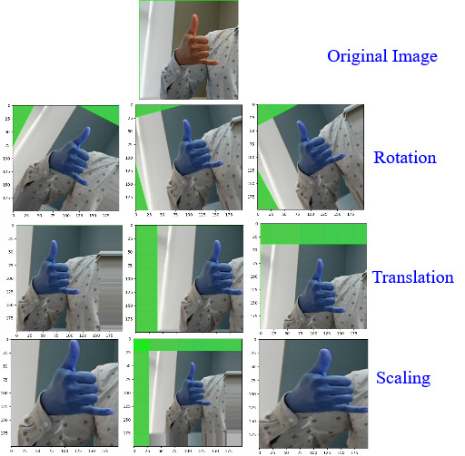
RTS Technique
Randomly applied -30 to +30 degrees to rotate the image
x-axis and y-axis translation range between -40 to +40
Scaling factor ranges between 0.2 to 1.5
Figure: RTS process of an input image.

Slide 16
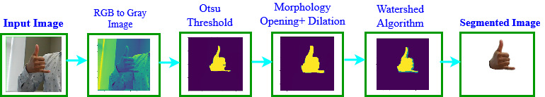
Segmentation Approach
© 2020 GOOGLE LLC
Atsu Thresholding Segmentation Used Here.
The segmentation process consists of three steps, i) Otsu Thresholding, ii) Morphological analysis: dilation through opening morphology, and iii) Watershed algorithm.
Figure 4. Segmentation process of an input image.

Slide 17
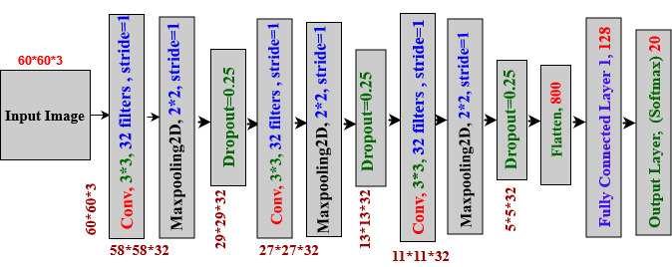
Classification
Convolutional Neural Network Used Here
Figure. Proposed CNN Architecture
Notes:
Based on the obtained features, two classifiers were used for character recognition. One is Suppurt vector machine and the other is Light GBM.

Slide 18
Evaluation with the original dataset
Firstly, trained with non-segmented images, and tested original test dataset achieved 97.50%.
Secondly, trained with segmented images and tested with original images achieved 98.80%
Thirdly, trained with original images and tested with RTS version images achieved 66.00%
Methods | Segmentation | Test Dataset | Recognition Accuracy (%)
CNN Training with Original Images | No | Original 30% test dataset | 97.50
CNN Training with Original Images | Yes | Original 30% test dataset | 98.80
CNN Training with Original Images | Yes | RTS version of 30% test dataset | 66.00
Table 1. Classification accuracy (%) of the proposed method with the original dataset.

Slide 19
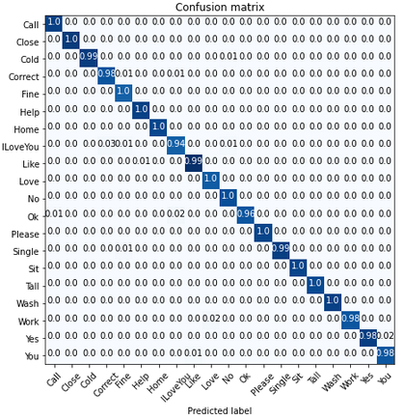
Evaluation with the original dataset
Figure: Confusion Matrix of CNN methods with the original segmented dataset

Slide 20
Evaluation with RTS version dataset
Method | Segmentation | Test Dataset | Precision | Recall | F1 score | Recognition Accuracy (%)
CNN Train with RTS Version Dataset | No | Original Images | 98.00 | 98.00 | 99.00 | 98.50
CNN Train with RTS Version Dataset | Yes | Original Images | 99.00 | 99.00 | 99.00 | 99.30
CNN Train with RTS Version Dataset | Yes | RTS version Images | 99.00 | 99.00 | 99.00 | 99.10
Table 2. Precision, recall, F1 score values and classification accuracy (%) of the proposed method with RTS version dataset
Table 5. Selected paramters of SVM for different datasets.

Slide 21
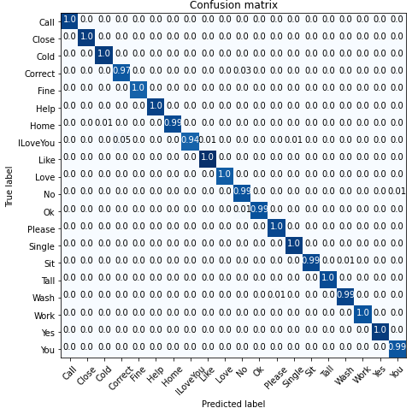
Evaluation with RTS version dataset
Figure: Confusion Matrix of CNN methods with the RTS version Images

Slide 22
Evaluation with five sign dataset
Methods | Segmentation | Test Dataset | Recognition Accuracy (%)
CNN Train with five sign word dataset | Yes | Original 15 test images | 93.33
CNN Train with five sign word dataset | Yes | RTS version images generated from 15 test images. | 74.00
CNN Train with RTS version of five sign word Images | Yes | Original 15 test images | 100
CNN Train with RTS version of five sign word Images | Yes | RTS version images generated from 15 test images. | 98.00
Table . Classification accuracy (%) of the proposed methods with five sign word dataset [29].

Slide 23
Results Analysis
Reference | Dataset | Number of Images | Segmentation | Test Set | Reported Accuracy (%)
Rahim et al. [4],2019 | 20-Sign dataset | 18000 | yes | 30% of the Dataset | 97.28
Mujahid et al. [29], 2021 | 5-Sign dataset | 216 | no | 15 Test Images | 97.68
Proposed (CNN Train and Test with RTS dataset) | RTS version dataset of [4] | 190,000 | yes | Same as [4] | 99.30
 | RTS version dataset of [29] | 2160 | yes | Same as [29] | 100
Table . Comparison accuracy (%) of the proposed method with the existing state of the art methods.

Slide 24
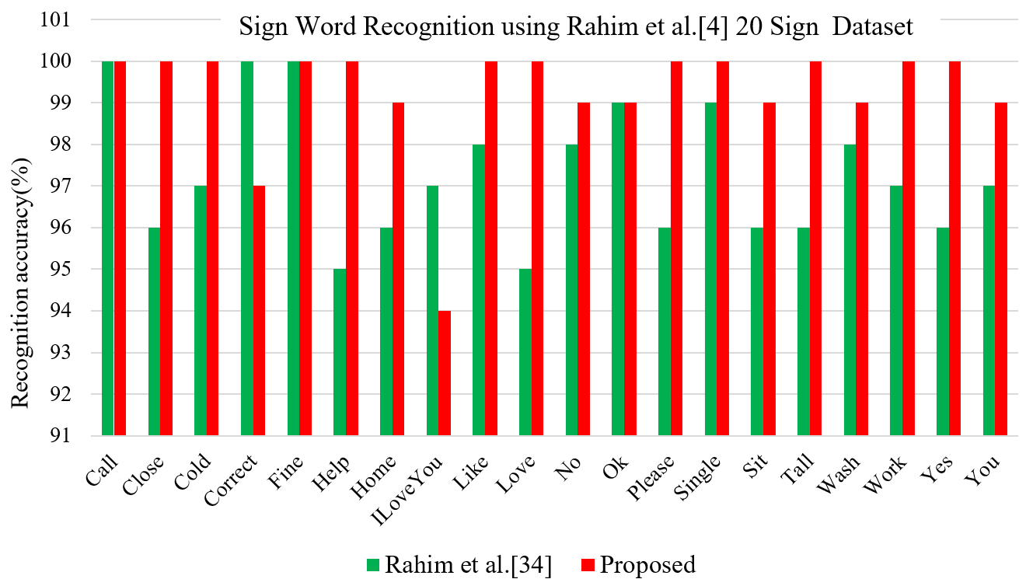
Comparison with Previous Studies
Figure. Class wise sign word recognition (%) of the proposed method compared with the existing [4] methods

Slide 25
Conclusion
Presented method based on CNN for recognizing the word sign for the original dataset, RTS dataset and five sign word dataset.
The overall performance follows the process of segmentation, RTS version of the dataset, and classification.
In segmentation, the part of the sign gesture is identified by following the steps, Otsu Thresholding, Morphological Analysis: dilation through opening morphology, and Watershed Algorithm.
To increase the dataset's size and make a RTS invariant model, applied RTS strategies that improve the recognition functionality.
Convolutional neural network (CNN) methods applied here for effective classification.
For 20 sign dataset model produced 99.10% accuracy
for the RTS version test images and 99.30% accuracy for the original test image.
For the five sign dataset model has produced 98.00% accuracy RTS version test images and 100% accuracy for the original test image.

Slide 26
Conclusion
the overall results show that the proposed method significantly outperforms the recognition of sign words with or without RTS images compared to state-of-the-art methods.
In future work, we will be collected more continuous and discrete sign word data to evaluate a hybrid method for making mobile applications and other scenarios.
Moreover, we will be focused design a data fusion based advanced convolutional neural network on enhancing the sign word recognition precision.

Slide 27
Thank you for your kind attention

